Slide 1
Welcome! In this task you will be presented with a series of letters appearing one after another in the centre of the computer screen.
You will be asked to complete three different versions of this task, the 1-back, 2-back, and 3-back.
The next few slides will provide you with instructions on how to complete each version of this task.
Press 1 to continue.

Slide 2
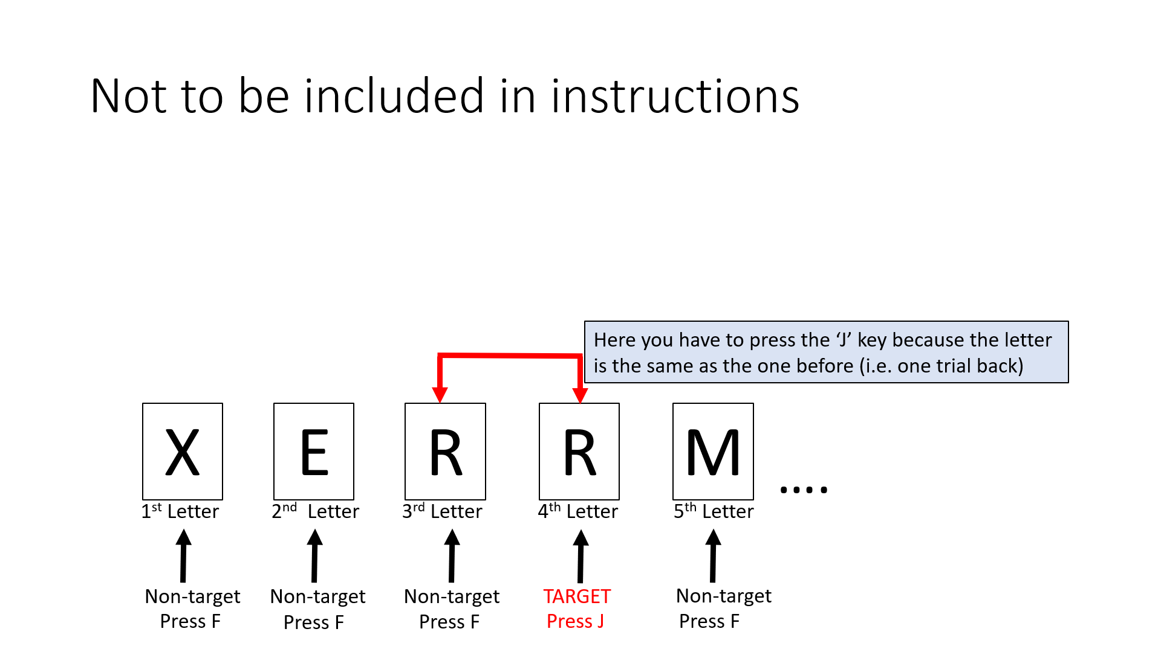
1-back
If you are asked to do a 1-back, press the ‘J’ key each time the current letter is exactly the same as the one presented before (i.e. 1 position back in the sequence).
Otherwise, press the ‘F’ key.
If you understand these instructions, please press 1 to continue.

Slide 3
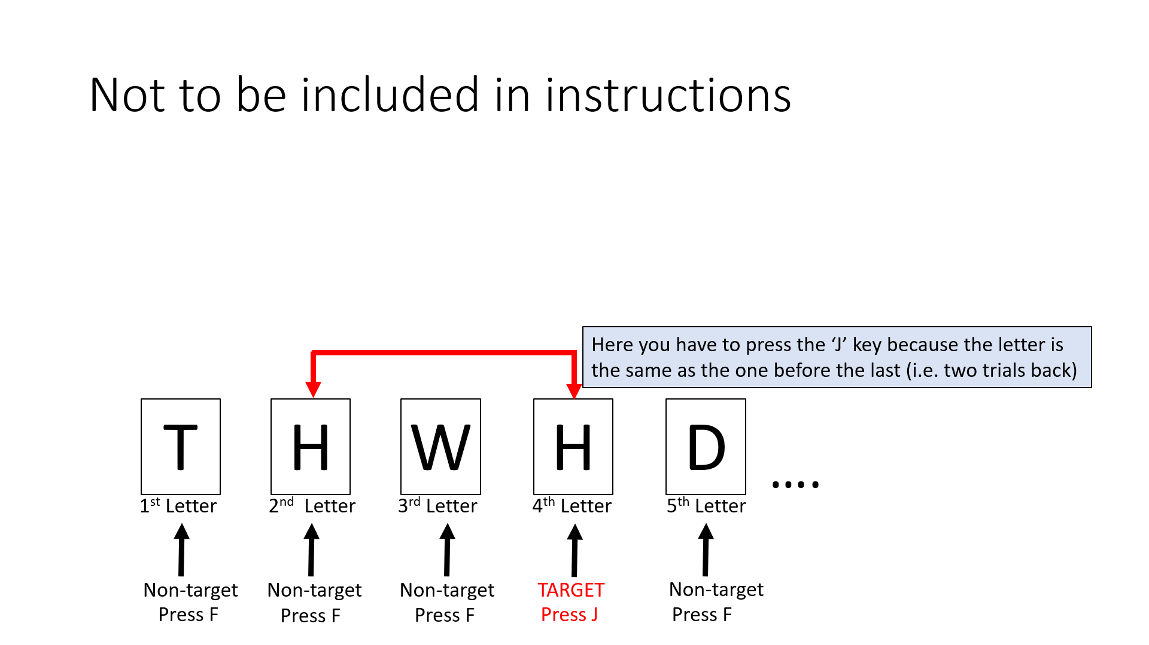
2-back
If you are asked to do a 2-back, press the ‘J’ key each time the current letter is exactly the same as the one presented before the last (i.e. 2 positions back in the sequence).
Otherwise, press the ‘F’ key .
If you understand these instructions, please press 1 to continue.

Slide 4
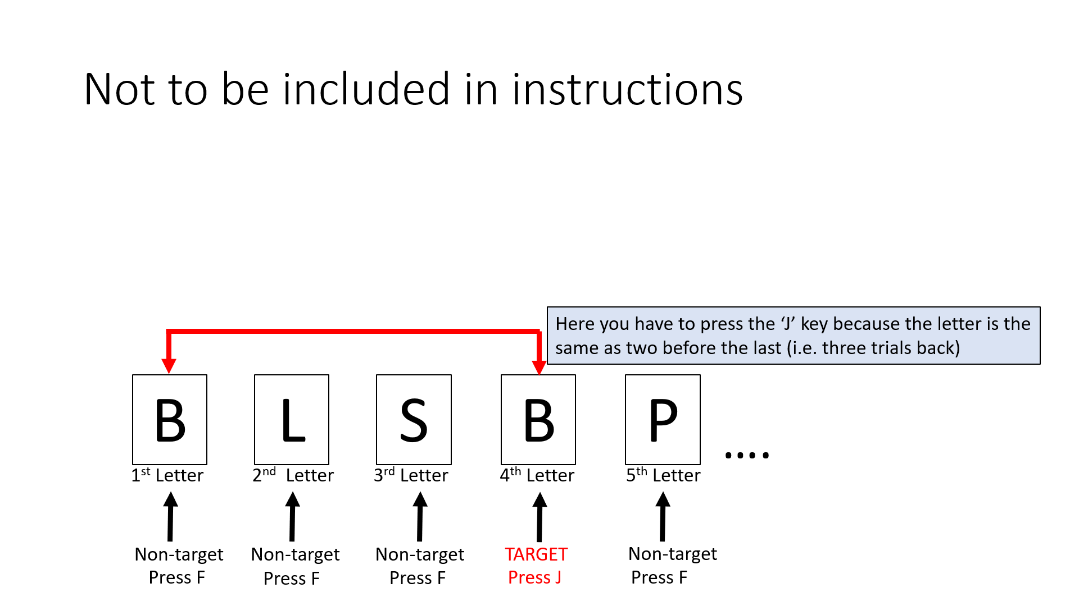
3-back
If you are asked to do a 3-back, press the ‘J’ key each time the current letter is exactly the same as the two presented before the last (i.e. 3 positions back in the sequence).
Otherwise, press the ‘F’ key .
If you understand these instructions, please press 1 to continue.

Slide 5
Before the real task, you will go through a practice session to help you learn the task. During the practice session, you will receive feedback on your performance.
During the real task, you will not receive feedback on your performance.
Each letter will only be presented for a short time. Please pay close attention and respond as quickly and accurately as you can.
If you understand these instructions, please press 1 to continue.

Slide 6
PRACTICE SESSION
You will receive feedback on your performance.
Press 1 to start the practice session.

Slide 7
Get ready to do a 1-back. Press 1 to start.
Press the ‘J’ key each time the current letter is exactly the same as one position back in the sequence. Otherwise, press the ‘F’ key.

Slide 8
Get ready to do a 2-back. Press 1 to start.
Press the ‘J’ key each time the current letter is exactly the same as two positions back in the sequence. Otherwise, press the ‘F’ key.

Slide 9
Get ready to do a 3-back. Press 1 to start.
Press the ‘J’ key each time the current letter is exactly the same as three positions back in the sequence. Otherwise, press the ‘F’ key.

Slide 10
Congratulations! You have finished the practice portion. Please inform the experimenter.

Slide 11
Would you like to repeat 1-back practice?
Press the ‘y’ key for YES
Press the ‘n’ key for NO

Slide 12
Would you like to repeat 2-back practice?
Press the ‘y’ key for YES
Press the ‘n’ key for NO

Slide 13
Would you like to repeat 3-back practice?
Press the ‘y’ key for YES
Press the ‘n’ key for NO

Slide 14
You have completed the practice session and will now start the real task.
If the task is not entirely clear to you, please tell the experimenter now.
If you do not have any questions, press 1.

Slide 15
During the experiment, you will do the same tasks you have practiced (the 1-, 2-, and 3-back) multiple times for a total of ~15 minutes.
However, you will NOT receive feedback on your performance.
Remember, the letters are only presented for a brief period of time. Please try to work as quickly and accurately as possible.
If you have no questions, press 1 to start the task.

Slide 16
Thank you so much for your participation! You have finished the task. Please inform the experimenter.

Slide 17
Do not include slides beyond this point

Slide 18
Would you like to repeat the practice?
Press the ‘Y’ key for “yes”
Press the ‘N’ key for “no”

Slide 19
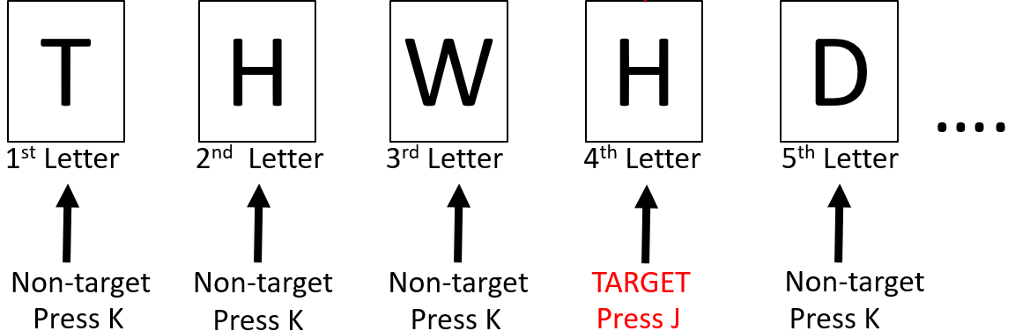
In this test do: a 2-back.
Press the ‘J’ key each time the current letter is exactly the same as the one presented before the last (i.e. 2 positions back in the sequence).
Otherwise, press the ‘K’ key .
Press the SPACEBAR to start

Slide 20
Now you are done the practice session. Unless you have questions about the task, we will start with the real task.
If you need more information about the task or the procedure is not entirely clear to you, please tell the experimenter now.
During the test, you will do the same tasks that you have practiced (the 0-, 1-, and 2-back) multiple times.
The test will last approximately 25 minutes.
This time you will NOT receive feedback on your performance.
You are allowed to take a break___________________.
Please try to work as accurately as possible.
Press the SPACEBAR to proceed to the next slide.

Slide 21
ACTUAL N-BACK TASK
You will NOT receive feedback on your performance.
The next slide will provide you with further instructions.
Press the SPACEBAR to proceed to the next slide.

Slide 22
In this test do: a 0-back.
Press the ‘J’ key if the current letter is an ‘X’.
Otherwise, press the ‘K’ key.
Press the SPACEBAR to start

Slide 23
In this test do: a 1-back.
Press the ‘J’ key each time the current letter is exactly the same as the one presented before (i.e. 1 position back in the sequence).
Otherwise, press the ‘K’ key.
Press the SPACEBAR to start

Slide 24
In this test do: a 2-back.
Press the ‘J’ key each time the current letter is exactly the same as the one presented before the last (i.e. 2 positions back in the sequence).
Otherwise, press the ‘K’ key .
Press the SPACEBAR to start

Slide 25
Not to be included in instructions
F
X
W
B
A
X
….
1st Letter
2nd Letter
3rd Letter
4th Letter
5th Letter
6th Letter
Non-target
TARGET
Non-target
Non-target
Non-target
TARGET
Press K
Press J
Press K
Press K
Press K
Press J

Slide 26
Not to be included in instructions
Here you have to press the ‘J’ key because the letter is the same as the one before (i.e. one trial back)
X
E
R
R
M
….
1st Letter
2nd Letter
3rd Letter
4th Letter
5th Letter
Non-target
Non-target
Non-target
TARGET
Non-target
Press F
Press F
Press F
Press J
Press F

Slide 27
Not to be included in instructions
Here you have to press the ‘J’ key because the letter is the same as the one before the last (i.e. two trials back)
T
H
W
H
D
….
1st Letter
2nd Letter
3rd Letter
4th Letter
5th Letter
Non-target
Non-target
Non-target
TARGET
Non-target
Press F
Press F
Press F
Press J
Press F

Slide 28
Not to be included in instructions
Here you have to press the ‘J’ key because the letter is the same as two before the last (i.e. three trials back)
B
L
S
B
P
….
1st Letter
2nd Letter
3rd Letter
4th Letter
5th Letter
Non-target
Non-target
Non-target
TARGET
Non-target
Press F
Press F
Press F
Press J
Press F

